Slide 1
Quality Measure Tooling

Slide 2
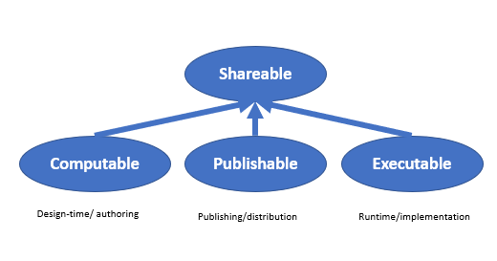
Content Capabilities

Slide 3
Authoring Capabilities
Validate (syntax and semantics)
Test (unit, component, integration, system)
Iterate
Share

Slide 4
Publishing Capabilities
Search
Retrieve
Manage change
Determine requirements

Slide 5
Evaluation Capabilities
Evaluate
Stable and specific dependencies

Slide 6

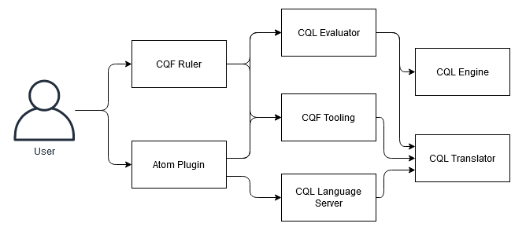







Components

Slide 7
Artifact Representation
Library
Measure
PlanDefinition

Slide 8
Artifact Components
Metadata
Logic
Structure

Slide 9
Metadata
Informal
Identifiers
Description
Categories
References
Guidance
Formal
Identity and lifecycle
Classifiers
Dependencies
Data requirements

Slide 10
Generated Content
Structured
Dependencies (libraries, terminology)
Data Requirements
Parameters (in/out)
Narrative (semi-structured, unstructured)
Human-readable

Slide 11
Build Process
Input (Atom)
Refresh (CQFTooling)
Output (Publisher)

Slide 12
Refresh Tooling
Translates all CQL
Refreshes generated Library content
Refreshes generated Measure content
Bundles test cases
Bundles measures
Optionally posts bundled content to a target server

Slide 13
Library Resource
Input
Refresh
Publish
Identity/Lifecycle
Identity/Lifecycle
Identity/Lifecycle
Narrative
Informal Metadata
Informal Metadata
Informal Metadata
Formal Metadata
Formal Metadata
CQL Library
Content
Content

Slide 14
Measure Resource
Input
Refresh
Publish
Identity/Lifecycle
Identity/Lifecycle
Identity/Lifecycle
Narrative
Informal Metadata
Informal Metadata
Informal Metadata
Formal Metadata
Formal Metadata
Structure
Structure
Structure

Slide 15
Measure Bundles
Input (MAT)
Refresh
Measure
Measure
Primary Library
Primary Library
Shared Library
Shared Library
ValueSet(s)
Test(s)

Slide 16
Sharing via Services
Authoring
Publishing
Evaluation
Guideline Development
Decision Support Services
Terminology Service (e.g. VSAC)
Measure Developers
Measure Evaluation Services
Decision Support Authors
Knowledge Repository
EHRs
Quality Improvement Agencies
SMART Apps
Professional Societies
Backend Services Applications
...
...

Slide 17
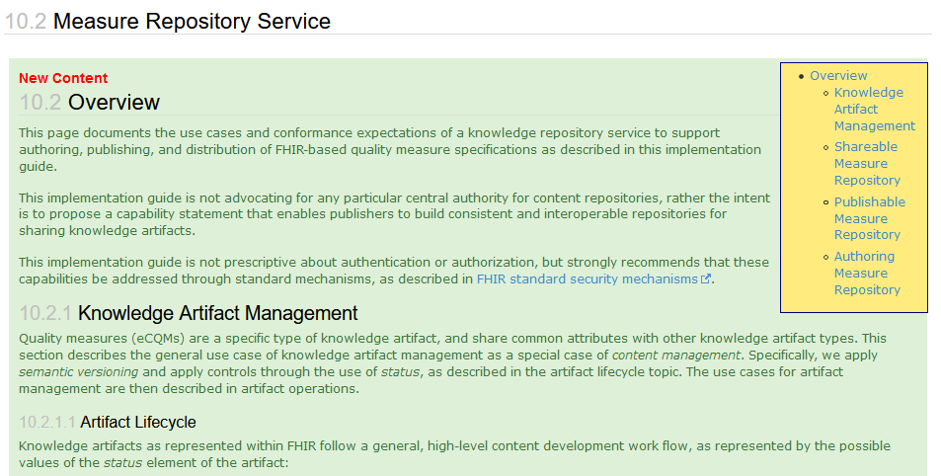
Knowledge Repository
Artifact Lifecycle
Artifact Identity
Versioning
Operations
Capabilities
http://hl7.org/fhir/us/cqfmeasures/2021May/measure-repository-service.html

Slide 18
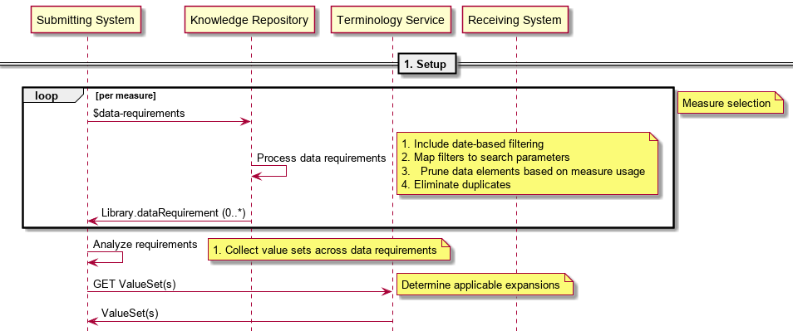
Artifact Setup

Slide 19
Library/$evaluate
Similar to Measure/$evaluate-measure:
GET [base]/Library/$evaluate?subject=Patient/123
Response:
Parameters
One for each named expression in the library
Measure Evaluation Services
Libraries
Measures
http://hl7.org/fhir/uv/cpg/OperationDefinition-cpg-library-evaluate.html

Slide 20
$cql
Ad-hoc CQL execution
GET [base]/$cql?subject=Patient/123
&expression=Patient.gender
Response:
Any
Resource (if the result is a singular resource)
Bundle (if the result is a list of resources)
Parameters (if the result is a data type)
Measure Evaluation Services
Libraries
Measures
http://hl7.org/fhir/uv/cpg/OperationDefinition-cpg-cql.html

